Slide 1
GENDER AND CLIMATE
-nasty neptunes

Slide 2
Gender inequality coupled with the climate crisis is one of the greatest challenges of our time. It poses threats to ways of life, livelihoods, health, safety and security for women and girls around the world.

Slide 3
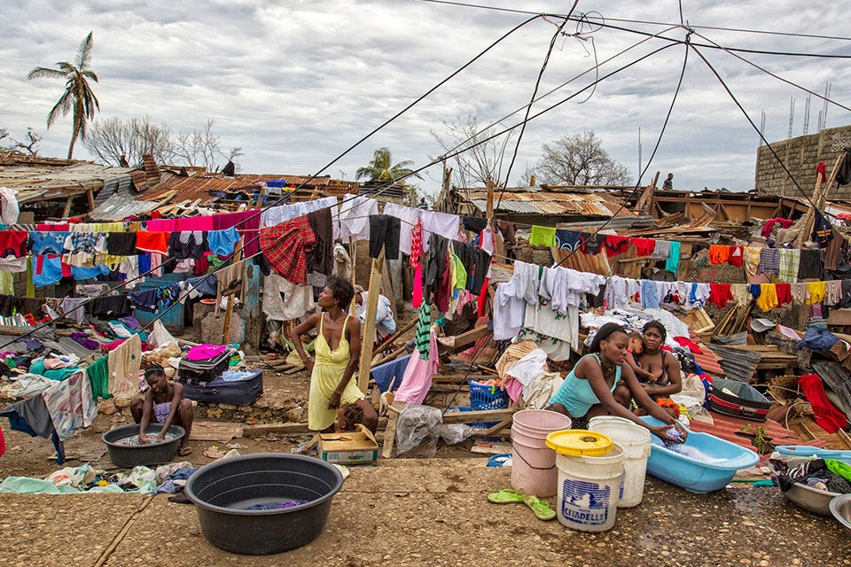
Historically, climate change scientists, researchers and policymakers have struggled with how to make the vital connections between gender, social equity, and climate change. As more and more data and research reveal their clear correlation, it’s time to talk about the disparate impacts of climate change and the linkages between women’s empowerment and effective, global climate action.
On International Women’s Day, we take a look at how climate change impacts women and girls, why gender equality is key to climate action, and what you can do to support solutions for women, by women.

Slide 4
How does climate change impact women and girls?
The climate crisis is not “gender neutral”. Women and girls experience the greatest impacts of climate change, which amplifies existing gender inequalities and poses unique threats to their livelihoods, health, and safety.
Across the world, women depend more on, yet have less access to, natural resources. In many regions, women bear a disproportionate responsibility for securing food, water, and fuel. Agriculture is the most important employment sector for women in low- and lower-middle income countries, during periods of drought and erratic rainfall, women, as agricultural workers and primary procurers, work harder to secure income and resources for their families. This puts added pressure on girls, who often have to leave school to help their mothers manage the increased burden.

Slide 5
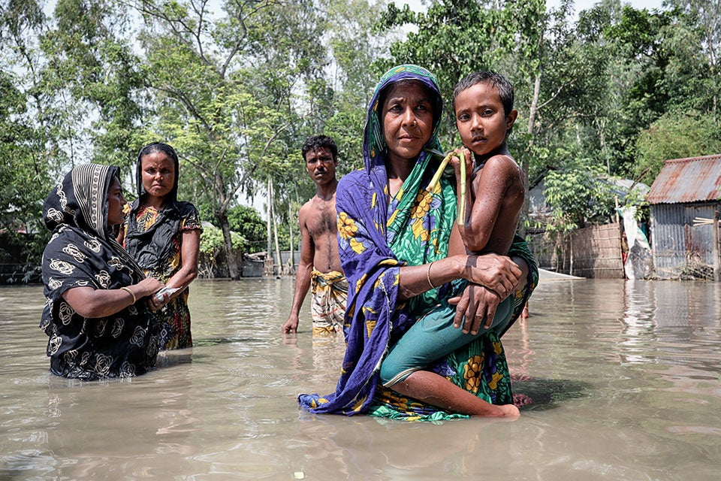
Nurun Nahar has two children and lives in a remote part of Islampur, Jamalpur.
When floods destroyed her house in Bangladesh in 2019, she had to move to a shelter.

Slide 6
Women's vulnerability to climate change
Women and girls are disproportionately impacted by climate change. They are more likely to be injured or die in disasters, and extreme heat can increase the risk of stillbirth. Women also tend to have less access to natural resources and are often responsible for securing food, water, and fuel.
Women's role in agriculture
Women make up a large portion of the agricultural labor force in developing countries. When women have access to the same resources as men, they can increase agricultural yields, which can help reduce world hunger and improve climate adaptation.

Slide 7

Climate change can affect men in many ways, including:
Reproductive Health: Air pollution can negatively impact the quality of semen in men.
Climate-induced displacement: Climate change can lead to displacement, which can disproportionately impact men, women, and transgender people.
Agriculture: Climate change impacts agriculture in many ways, including production and consumption. The impacts are not gender neutral, and are shaped by gender inequalities and structural barriers.

Slide 8
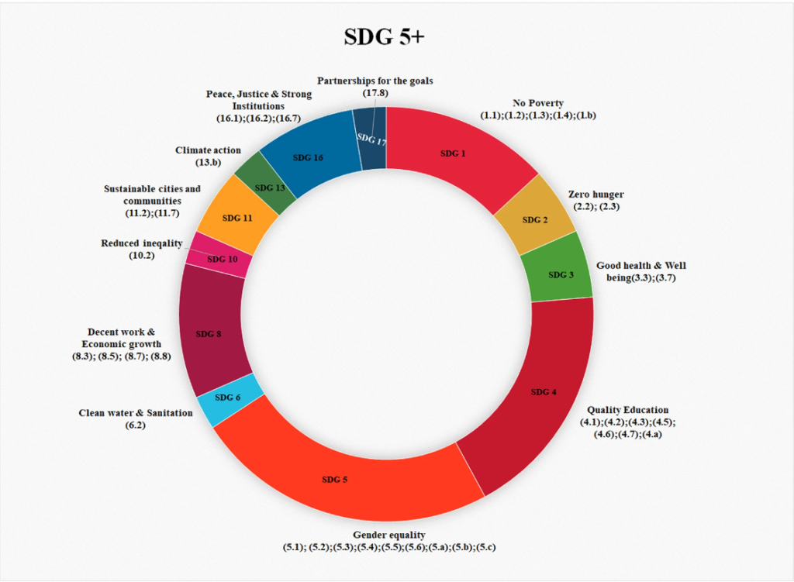

Slide 9
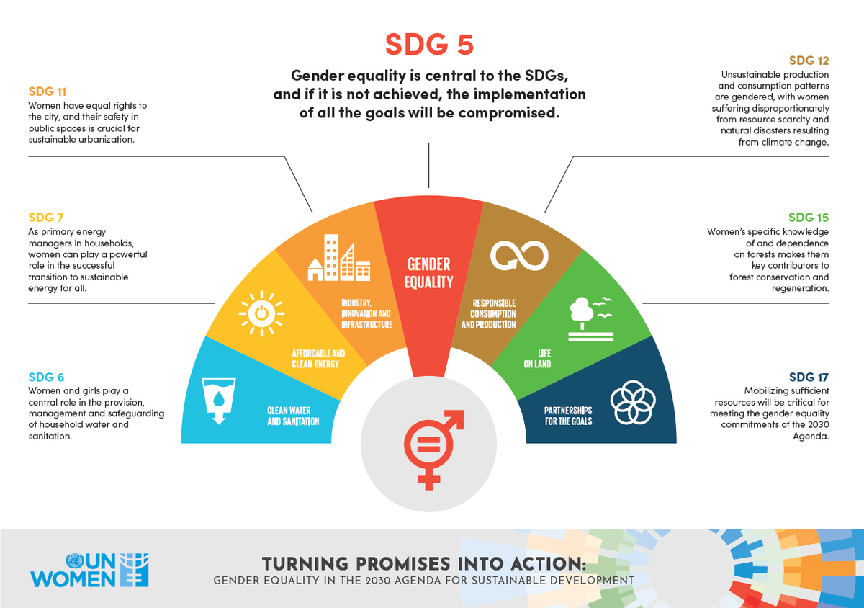

Slide 10
Why does gender equality matter when it comes to climate action?
While climate change is a threat for everyone, it does not affect everyone equally. The impacts of climate change perpetuate and magnify structural inequalities, such as those between women and men. This is especially true in many parts of the world where women rely on climate-sensitive work like agriculture and manual labour to make a living.
The climate crisis, just like nearly every other humanitarian and development challenge, has a greater impact on women. This is due to the unequal sharing of power between women and men, the gender gap in access to education and employment opportunities, the unpaid care burden, prevalence of gender-based violence, and all other forms of deep-rooted gender-based discrimination.

Slide 11
For example, women play a significant role in agricultural production, but often do not have equal access to agricultural resources and services or official decision-making processes concerning agriculture and climate change. According to one estimate, if all women smallholders received equal access to resources, their farm yields would rise by 20 to 30 percent, 100 to 150 million people would no longer go hungry, and carbon dioxide emissions could be reduced by 2.1 gigatons by 2050 through improved farm practices.
Even though a third of women’s employment worldwide is in the agricultural sector, women represent only 12.6 percent of landowners. This lack of control over resources translates into women receiving only 10 percent of total aid for agriculture, forestry, and fishing. It also means increased vulnerability, as women experience lower access to information about adaptation technologies, cropping patterns, and weather events. Giving women increased access to resources can reduce vulnerability and create more resilient households and communities.

Slide 12
In addition, involving women in decision-making can help drive the adoption of climate change policies and strengthen mitigation and adaptation efforts by ensuring they benefit the needs of women.
But often, women’s participation in decision-making and their climate leadership potential is hindered by their unpaid care responsibilities. Across the world, women carry out more than 75 percent of unpaid care work, or 3.2 times more than men. When climate-induced disasters hit, this figure only increases as women take on additional burdens to help their households and communities recover and rebuild

Slide 13
How can gender equality help address climate action?
For climate solutions to be effective, they must consider gender equality and women’s empowerment throughout.
A crucial step to assessing how the impacts of climate change impact women and men differently is conducting a gender analysis. This helps identify where inequalities and gender gaps exist and where to take relevant measures. Once we better understand the relative distribution of resources, opportunities, constraints, and power in a given context, we can then develop more effective, evidence-based climate policies and actions, addressing the needs of women and girls, as well as men and boys.
When developing and implementing new climate policies, we must ensure that men and women equally benefit from budgetary allocations to climate action. This enables everyone to employ their skills and leadership to respond to the crisis.
In return, climate policies that are synergized and integrated with gender equality objectives are more successful at achieving the deep transformations required to tackle the climate crisis and ensure social justice.

Slide 14
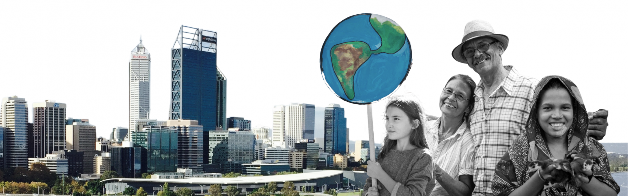

Slide 15
SOLUTION FOR EQUALITY & CLIMATE CHANGE
Reduce inequality: Eliminate discriminatory laws, policies, and practices. This includes ensuring equal access to education, employment, housing, health, and social protection.
Promote inclusive economic growth: Invest in health, education, social protection, and decent jobs, especially for young people, migrants, and refugees.
End poverty: Eradicate extreme poverty and hunger.
Combat climate change: Take urgent action to combat climate change and its impacts.
Conserve natural resources: Promote sustainable management of natural resources and ecosystems.
Promote gender equality: Gender equality is a fundamental human right and a necessary foundation for a peaceful, prosperous, and sustainable world.
Promote safe migration: Promote safe, regular, and responsible migration.
Reduce waste: Reduce waste, especially plastic bags, which are a major cause of marine pollution.
Promote sustainable consumption and production: Ensure sustainable consumption and production patterns.
Promote sustainable mobility: Support sustainable mobility.
Promote innovation: Promote innovation in sustainable construction and architecture.

Slide 16
THANKYOU

